Slide 1


Slide 2

Control Cloud Apps and Information Protection with Cloud App Security
Jan Vidar Elven | Microsoft MVP Enterprise Mobility
Cloud Architect @ Skill
@skillriver | gotoguy.blog
Notes:
Microsoft recently announced some exciting new updates and features for Cloud App Security. In this session we will see how you can control and limit access to cloud apps with proxy and conditional access, and we will look at how Cloud App Security can protect your information by applying classification labels and protection templates using Azure Information Protection!

Slide 3
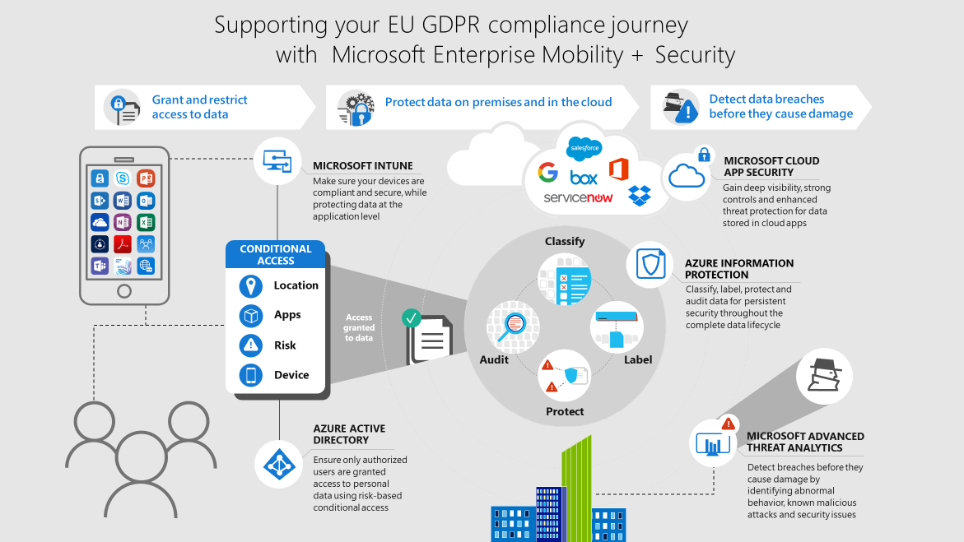
Supporting your EU GDPR Compliance Journey

Slide 4
The Firewall used to be the Security Perimeter
users
devices
apps
data
On-premises

Slide 5







Now it is fewer boundaries, more data, more complexity
OPPORTUNITY
On-premises

Slide 6
Microsoft Information Protection Solutions
Identity & access management
Threat protection
Information protection
Security management
Protect users’ identities & control access to valuable resources based on user risk level
Protect against advanced threats and recover quickly when attacked
Ensure documents and emails are seen only by authorized people
Gain visibility and control over security tools
Azure Active Directory
Conditional Access
Windows Hello
Windows Credential Guard
Advanced Threat Analytics
Windows Defender Advanced Threat Protection
Office 365 Advanced Threat Protection
Office 365 Threat Intelligence
Azure Information Protection
Office 365 Data Loss Prevention
Windows Information Protection
Microsoft Cloud App Security
Office 365 Advanced Security Mgmt.
Microsoft Intune
Azure Security Center
Office 365 Security Center
Windows Defender Security Center

Slide 7
How to Protect Sensitive Information
INFORMATION PROTECTION LIFECYCLE
Detect
Classify
Protect
Monitor
Scan & detect sensitive data based on policy
Classify data and apply labels based on sensitivity
Apply protection actions, including encryption, access restrictions
Reporting, alerts, remediation

Slide 8
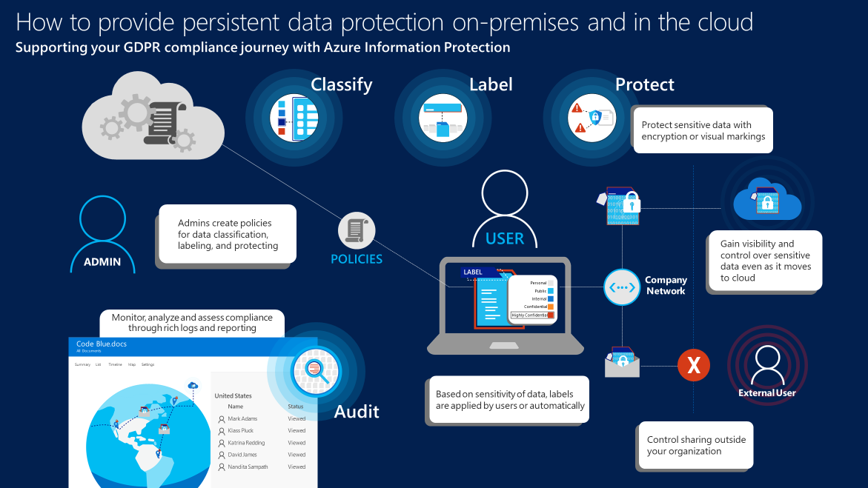
Supporting your EU GDPR Compliance Journey with Azure Information Protection

Slide 9
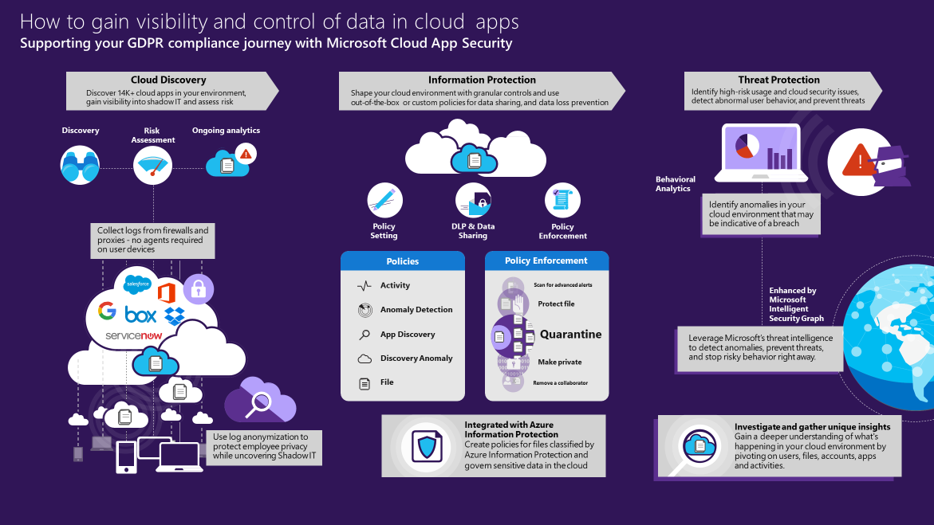

Slide 10

Azure Information Protection Integration with Cloud App Security
Requirements:
Cloud App Security license & Azure Information Protection Premium P2
Prereq’s:
Word: docm, docx, dotm, dotx
Excel: xlam, xlsm, xlsx, xltx
PowerPoint: potm, potx, ppsx, ppsm, pptm, pptx
PDF and image files will be available in future versions
Apps
Files stored in Box, SharePoint Online and OneDrive for Business
More cloud apps will be supported in future versions
Limitations
Files labeled with protection outside of Cloud App Security
Notes:
https://docs.microsoft.com/en-us/cloud-app-security/azip-integration

Slide 11

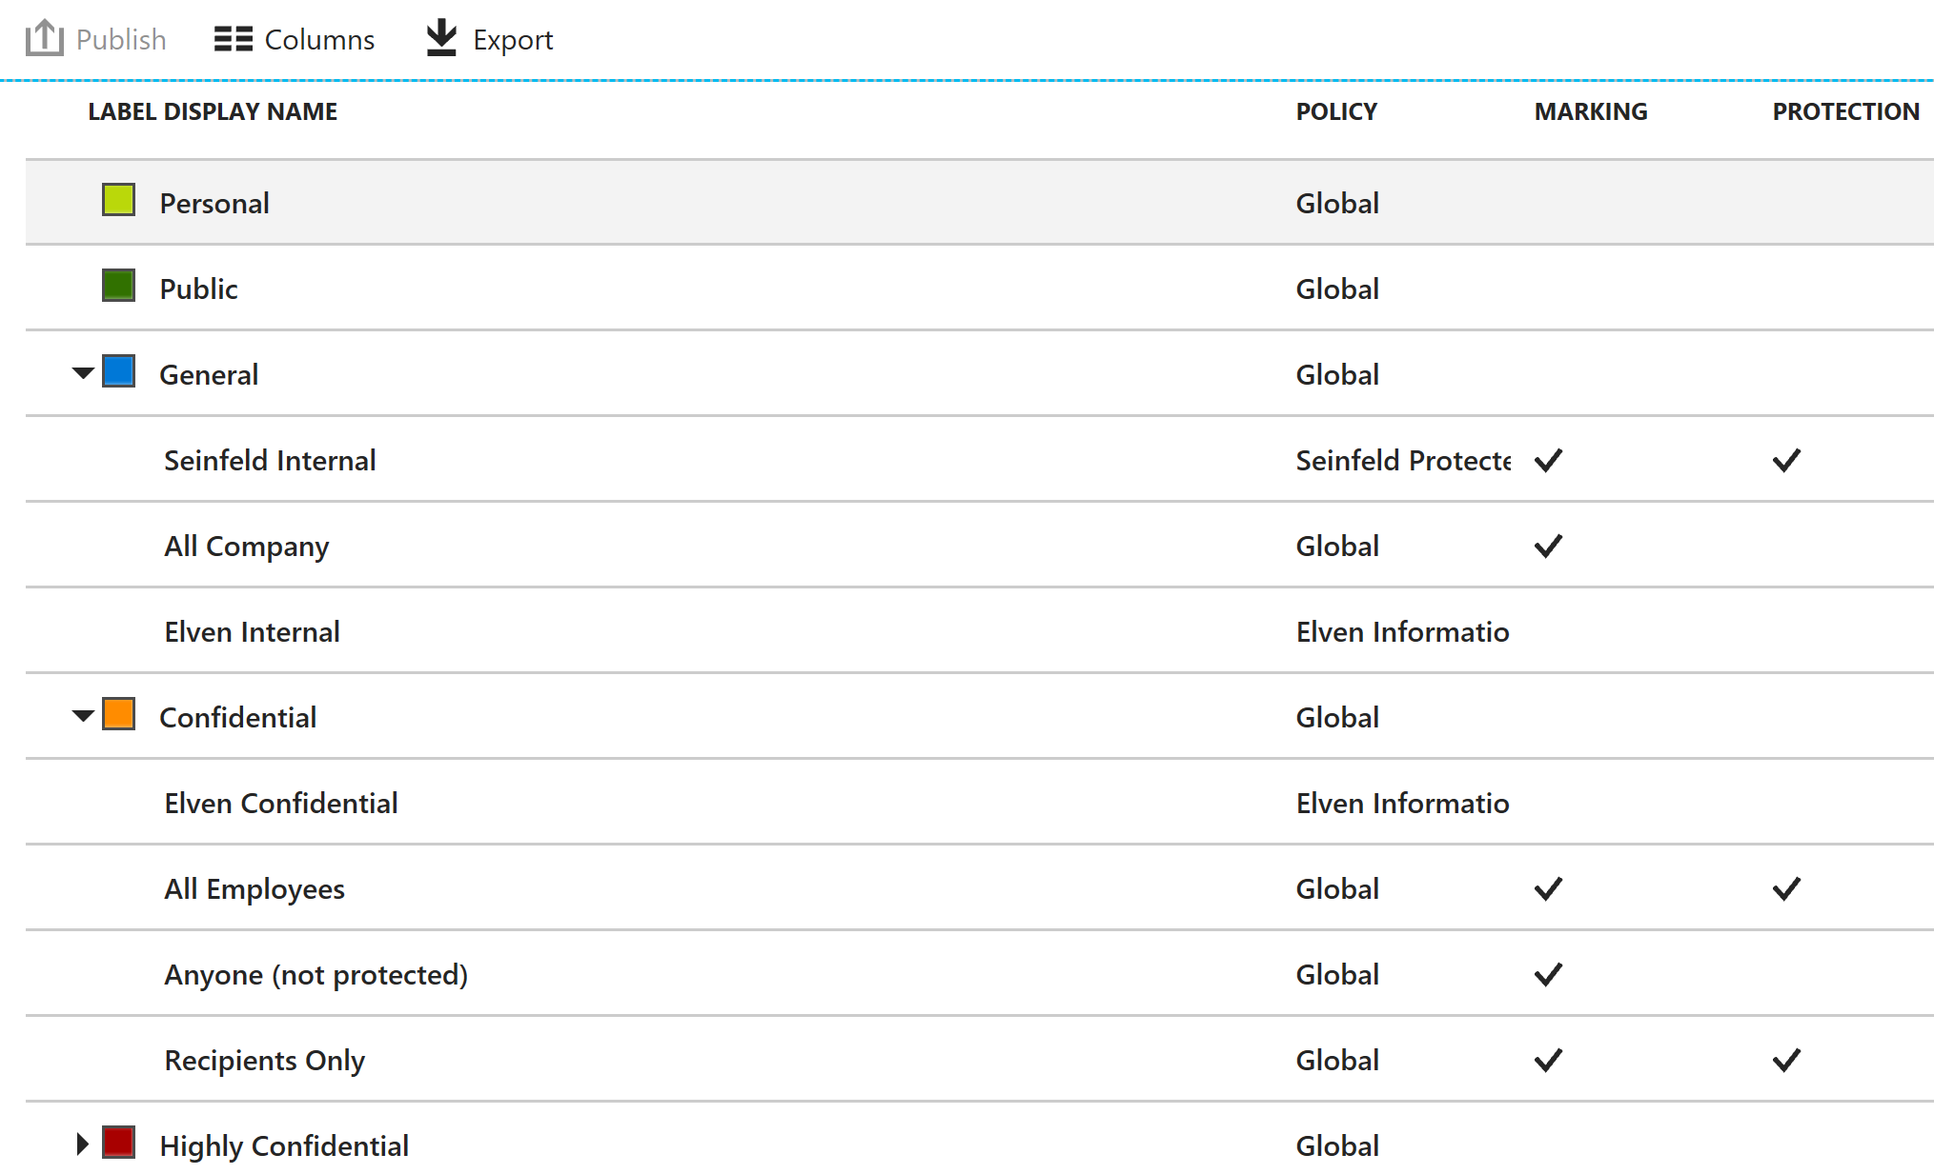
First set up and publish AIP policies

Slide 12
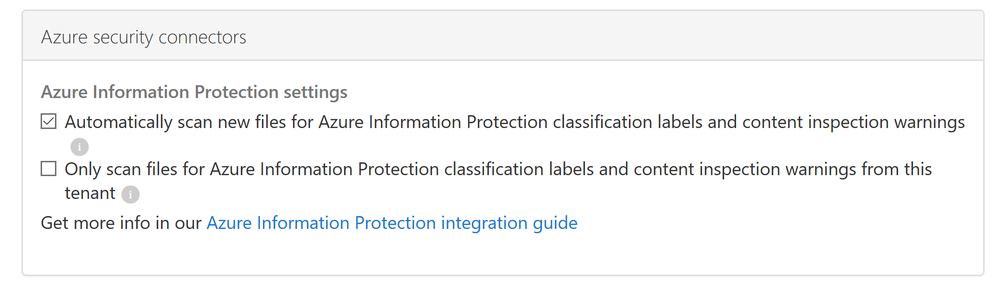
In CAS: Enable Scan of new files

Slide 13
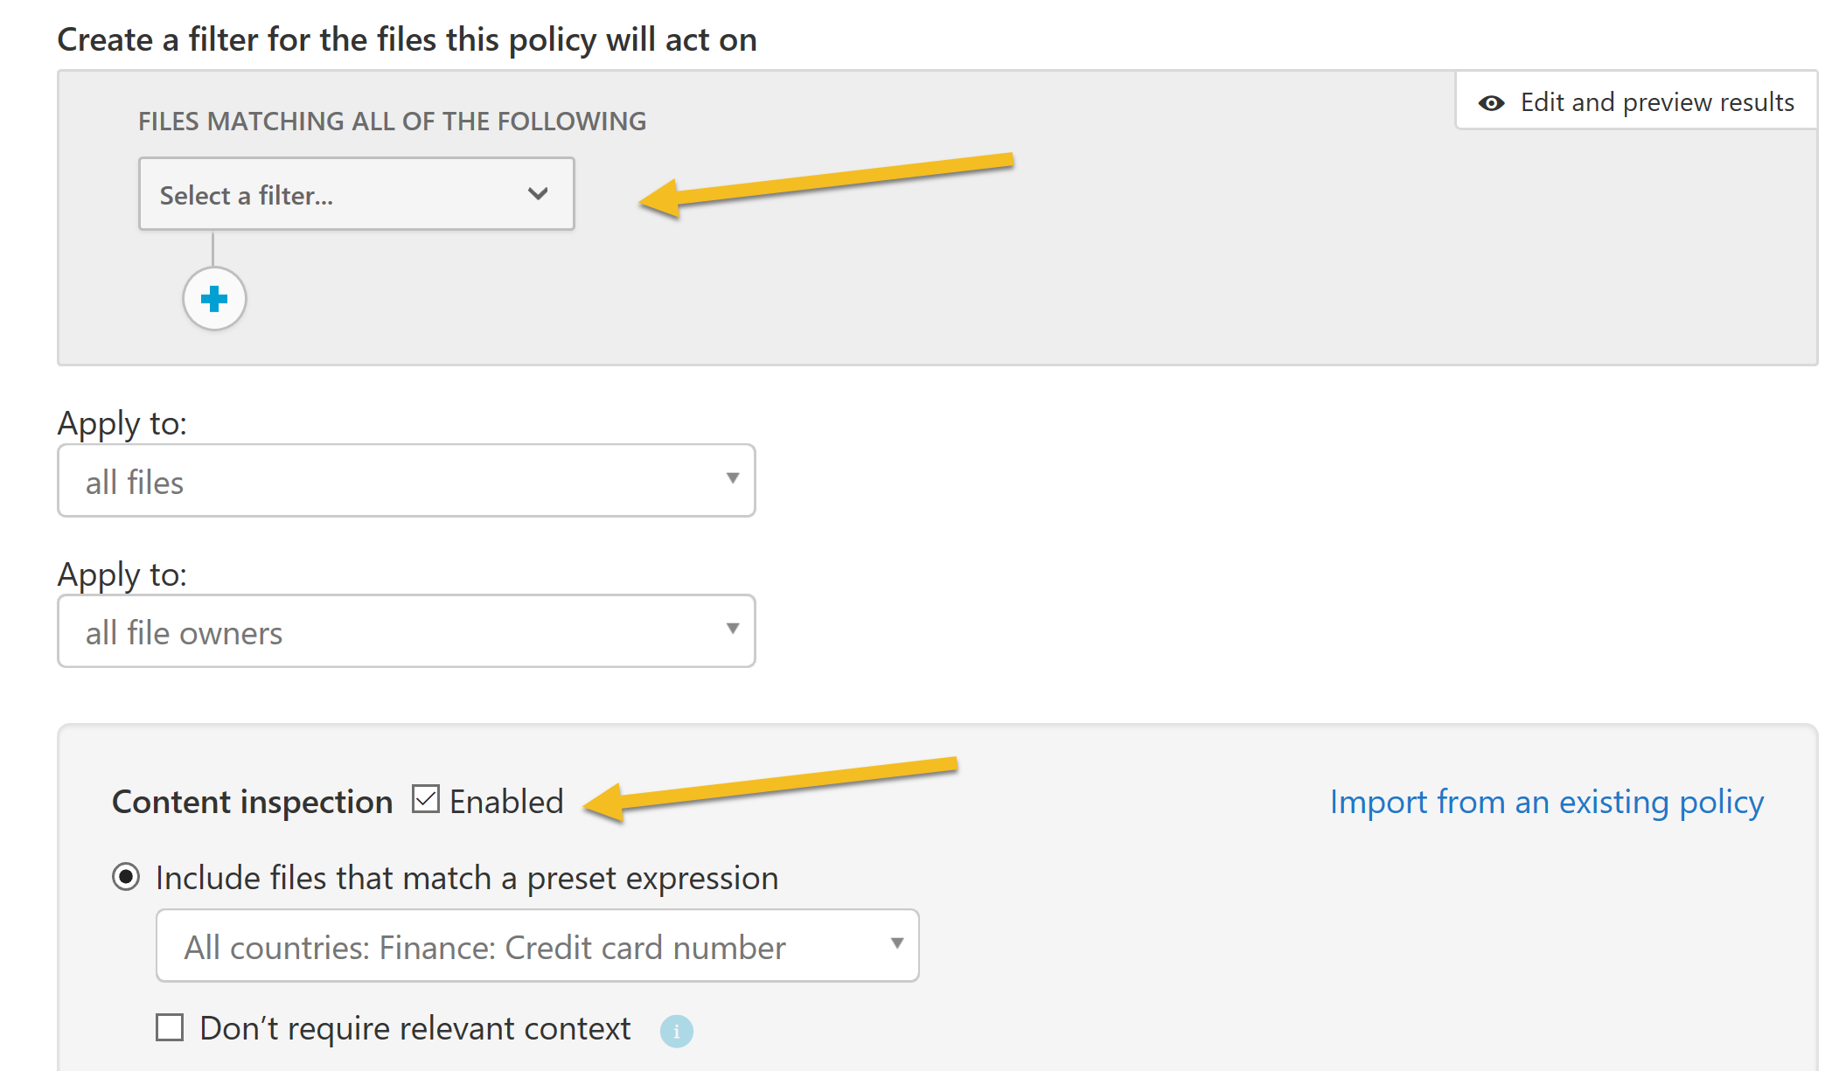
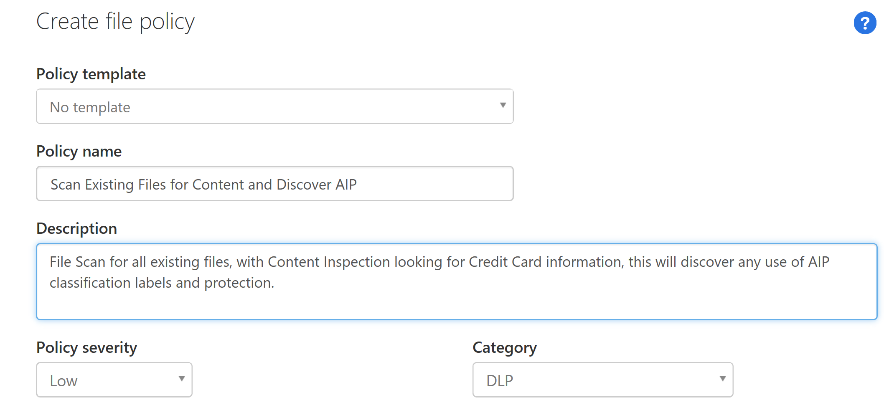
To detect existing files, file policy scan:

Slide 14
DEMO
https://portal.cloudappsecurity.com/

Slide 15

CAS Proxy for Azure AD Apps
Requirements:
Azure AD Premium P2 + CAS
Support:
SAML single sign-on apps
Office 365 apps currently not supported
Notes:
https://docs.microsoft.com/en-us/cloud-app-security/proxy-deployment-aad

Slide 16
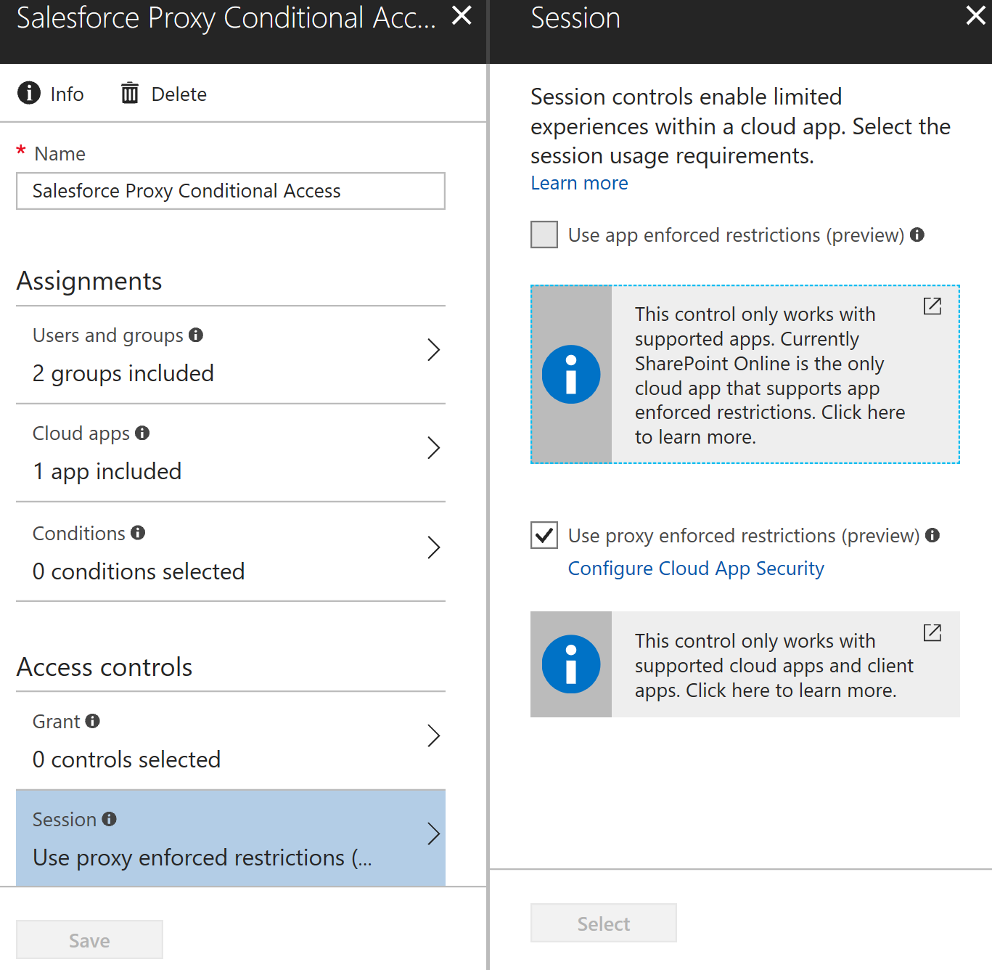
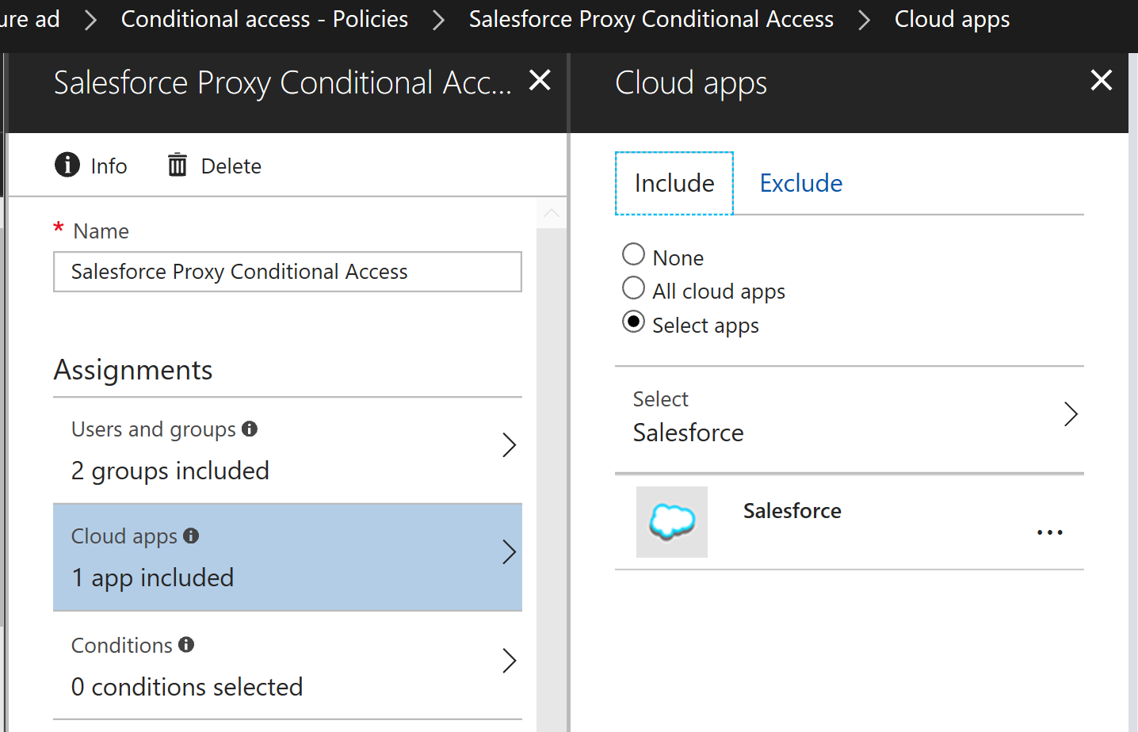
Proxy App Conditional Access

Slide 17
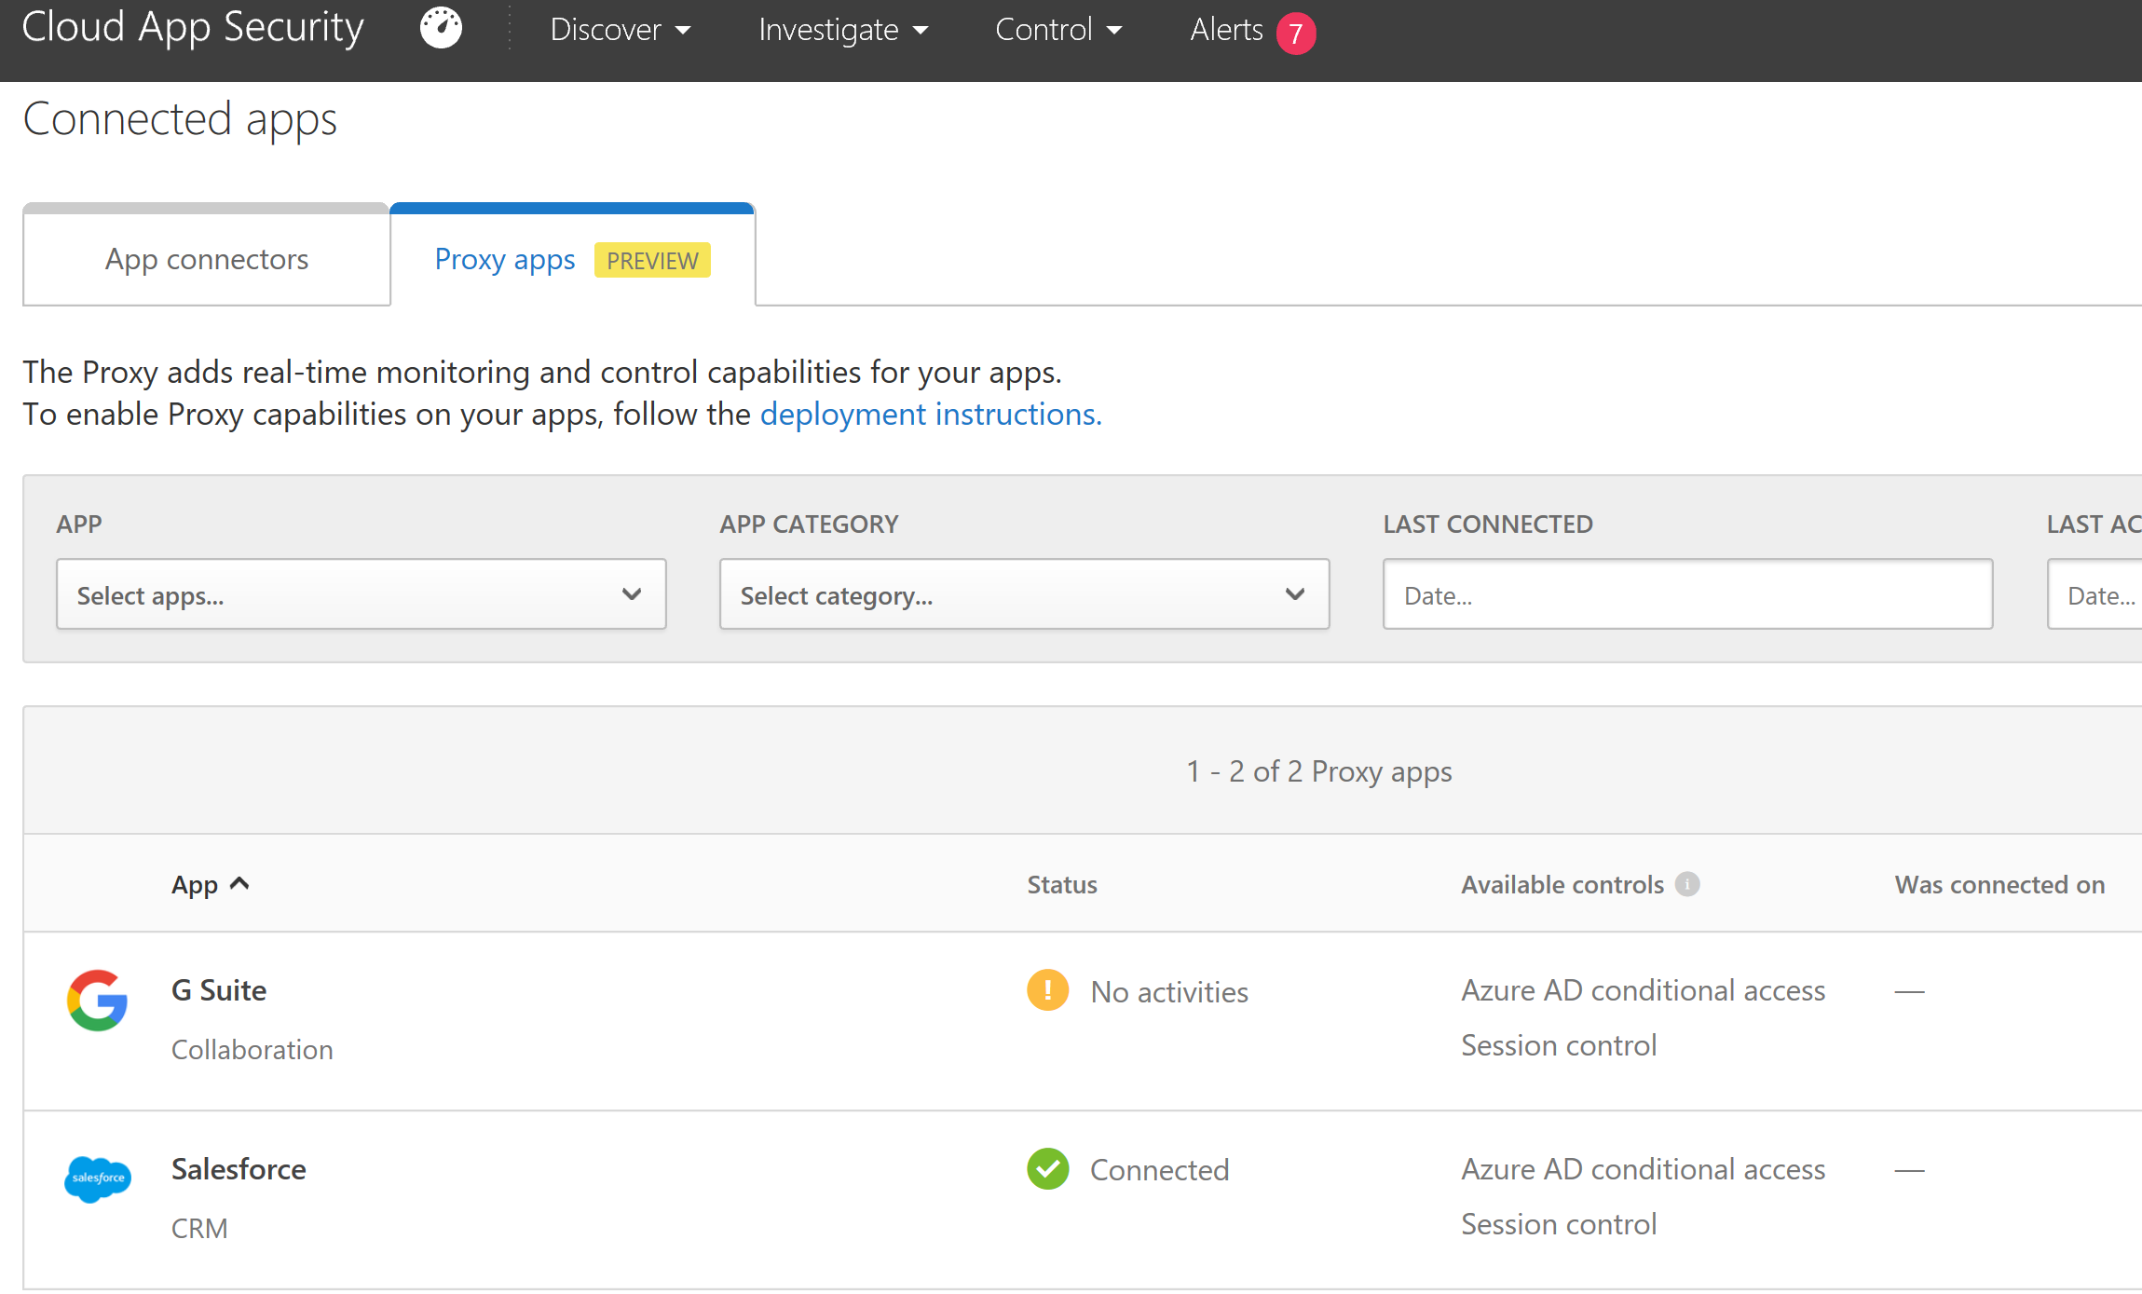
Connect Proxy Apps in CAS

Slide 18
Proxy App Policies
Access Policy
Real-time monitoring and control over access to cloud app
Based on user, location, device and app
Session Policy
Real-time session-level monitoring
Granular visibility with ability to take different action
Allow access while monitoring the session and/or limit specific session activities
Notes:
https://docs.microsoft.com/en-us/cloud-app-security/access-policy-aad
https://docs.microsoft.com/en-us/cloud-app-security/session-policy-aad

Slide 19
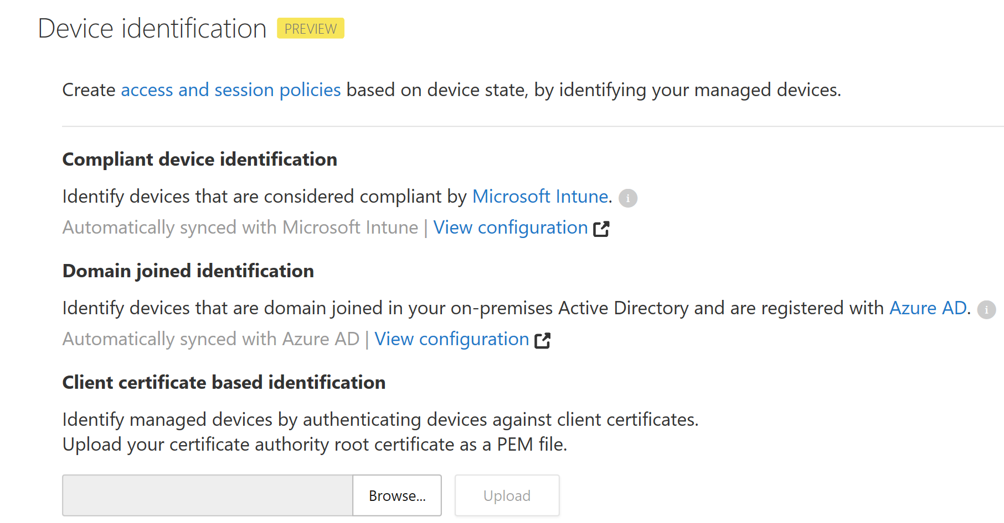
Device Identification

Slide 20
DEMO
https://aad.portal.azure.com
https://portal.cloudappsecurity.com/

Slide 21
Resources
Slides and demos from the conference will be available at github.com/nordicinfrastructureconference/2018 (bit.ly/2y7JhA3)
https://docs.microsoft.com/en-us/cloud-app-security/azip-integration
https://docs.microsoft.com/en-us/cloud-app-security/proxy-deployment-aad
@skillriver | gotoguy.blog

